Slide 1

Amazon India Data Analysis
By - Harsh Pandey (23053460)

Slide 2
Outline
Overview
Problem Statement
Challenges
Key Performance Indicator
Business Question
Graphs and Trends
Conclusion
Dashboard

Slide 3

Overview
The dataset highlights 120,378 total orders generating ₹71,050,985 in revenue, with an average order value (AOV) of ₹694.27. The most popular category is "Set" (50,284 orders), and Maharashtra contributed the highest revenue of ₹13,335,534.14. However, 14.28% of orders were canceled, with Bengaluru having the most cancellations.
Most orders used expedited shipping (82,922), but none were directly fulfilled by Amazon, indicating reliance on third-party fulfillment. Reducing cancellations and improving logistics, especially in key regions like Bengaluru and Maharashtra, are key areas for sales growth.

Slide 4
Problem Statement: Improving Sales and Reducing Cancellations on Amazon
Reducing High Cancellation Rate:
The current cancellation rate is 14.28%, with Bengaluru facing the highest cancellations. This impacts revenue and customer satisfaction. We need to identify and resolve key reasons behind cancellations, such as product issues or delivery delays, to improve order completion rates.
1
Improving Fulfillment by Implementing FBA:
0% of orders are fulfilled by Amazon (FBA), leading to slower deliveries through third-party sellers. Integrating Amazon’s Fulfillment by Amazon (FBA) service is essential to enhance delivery speed and customer satisfaction, ensuring faster, more reliable shipping.
2
Balancing Regional Sales Performance:
While Maharashtra generates high revenue, Bengaluru experiences high cancellation rates, leading to regional sales disparities. Addressing the underlying issues in underperforming regions will help create a more balanced sales distribution and improve overall revenue
3

Slide 5
Challenges
High Cancellation Rate (14.28%):
Understanding why cancellations are high, especially in Bengaluru, and addressing factors like product quality or delivery issues.
No Amazon Fulfillment (FBA):
Reliance on third-party fulfillment leads to slower shipping and potential errors, affecting customer satisfaction.
Regional Disparities:
High revenue in Maharashtra, but high cancellations in Bengaluru, indicating region-specific issues that need deeper analysis.
Product-Specific Cancellations:
Popular categories like "Set" face frequent cancellations, requiring investigation into product quality or sizing issues.
Shipping Expectations:
High demand for expedited shipping points to dissatisfaction with standard delivery speeds, challenging logistics optimization.

Slide 6
Key Performance Indicators (KPI)

Slide 7
1. Total Number of Orders
Definition: The total count of unique orders placed over a specific period.
Importance: Indicates overall demand and sales volume.
2. Total Revenue
Definition: The sum of all order amounts from shipped or completed orders.
Importance: A primary indicator of the business's financial health and sales performance.
3. Average Order Value (AOV)
Definition: The average amount spent per order.
Formula: Total Revenue ÷ Number of Orders
Importance: Helps evaluate customer spending behavior and can indicate opportunities for upselling or bundling to increase the AOV.
4. Order Cancellation Rate
Definition: The percentage of orders that were canceled out of the total orders.
Formula: (Canceled Orders ÷ Total Orders) × 100
Importance: A high cancellation rate can highlight issues in customer satisfaction, delivery, product descriptions, or pricing.
5. Fulfillment Method Mix
Definition: The proportion of orders fulfilled by different channels, such as Amazon (FBA) vs. Merchant Fulfillment.
Importance: Helps in understanding logistics efficiency, delivery times, and customer preferences for fulfillment methods.

Slide 8
6. Shipping Method Usage
Definition: The number of orders using various shipping methods (e.g., standard, expedited, same-day).
Importance: Tracks customer preference for delivery speed and can be used to improve logistics and shipping strategies.
7. Top-Selling Product Category
Definition: The product category with the highest number of orders.
Importance: Identifies key revenue drivers and customer preferences, which can inform inventory and marketing strategies.
8. Customer Return Rate
Definition: The percentage of shipped orders that are returned by customers.
Importance: A high return rate may indicate problems with product quality, customer expectations, or inaccurate product descriptions.
9. Geographical Sales Distribution
Definition: Revenue and order volume breakdown by location (e.g., state, city).
Importance: Helps identify the most profitable regions, target specific areas for marketing, and optimize logistics.
10. Revenue by Product Category
Definition: Total sales revenue generated from each product category.
Importance: Indicates which product categories contribute most to overall sales, helping to focus marketing and inventory efforts on high-performing categories.

Slide 9
Business Questions to Improve the Sales
1. What is the total number of orders in the dataset?
Answer: Total number of orders: 120,378
2. What is the total revenue generated from shipped orders?
Answer: Total revenue generated from shipped orders: ₹71,050,985
3. What is the average order value (AOV) for shipped orders?
Answer: Average order value (AOV) for shipped orders: ₹694.27
4. Which category has the highest number of orders?
Answer: Category with the highest number of orders: "Set" (50,284 orders
5. What percentage of orders were cancelled?
Answer: Percentage of orders that were cancelled: 14.28%

Slide 10
6. Most Cancelled order city wise and its Avg Price?
Answer:The most common type of clothing in canceled orders in Bengaluru is: kurta
The overall average price of canceled orders in Bengaluru is: ₹635.12
7. What is the top-selling product style?
Answer: Top-selling product style: JNE 3797
8. Which state generated the highest sales revenue?
Answer: State that generated the highest sales revenue: ₹13,335,534.14
9. How many orders used expedited shipping?
Answer: Number of orders using expedited shipping: 82,922

Slide 11
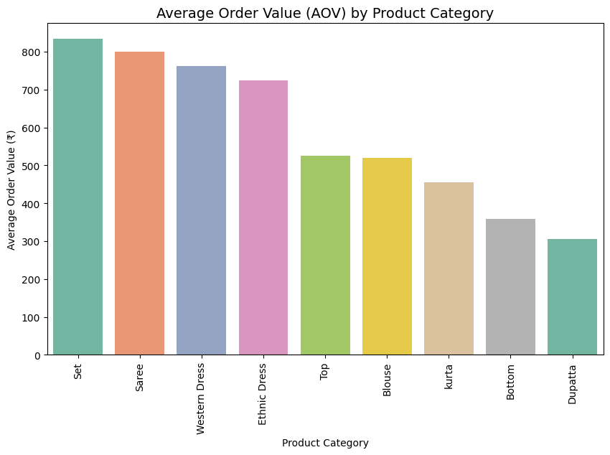
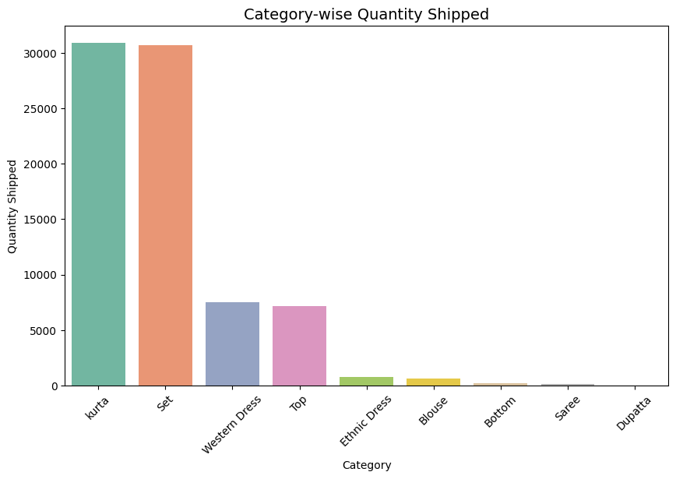
Average Order Value (AOV) by Product Category
Category-wise Quantity Shipped

Slide 12
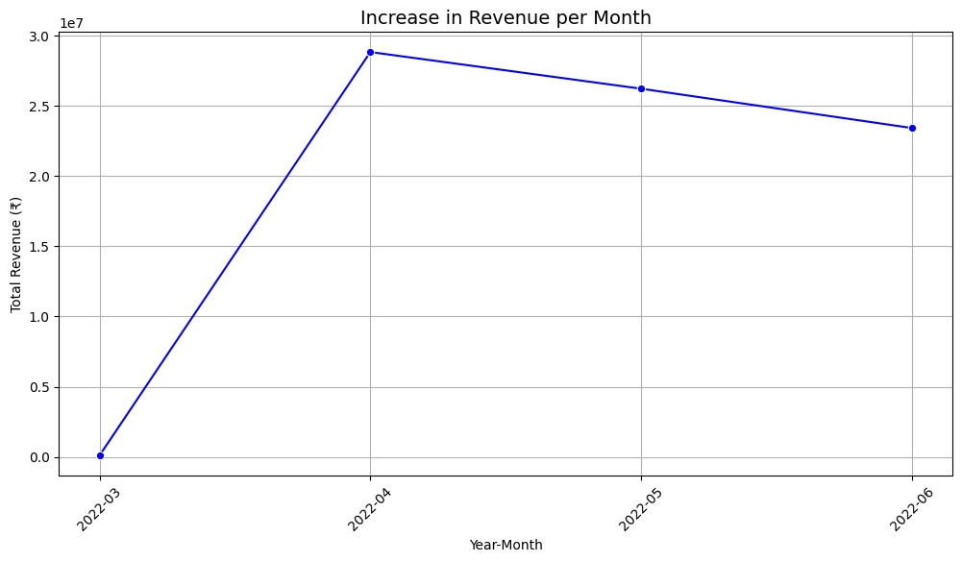
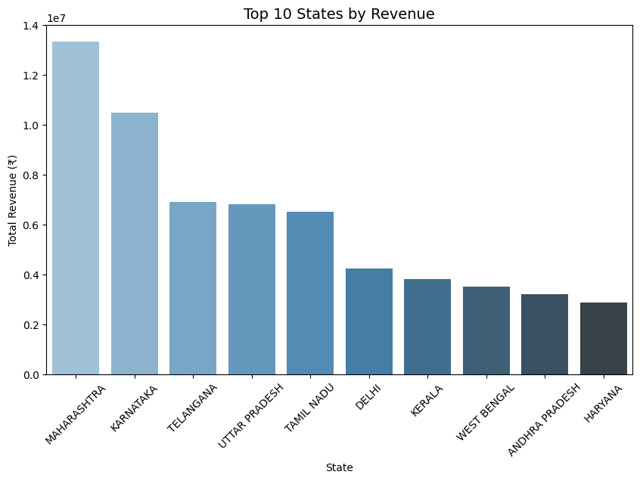
Increase in Revenue by Month
Revenue by top 10 State

Slide 13
Conclusion from the given Dataset
Order Overview:
There were 120,378 total orders in the dataset, with the total revenue from shipped orders amounting to ₹71,050,985. The average order value (AOV) for shipped orders was ₹694.27.
Top Categories:
The most frequently ordered category is "Set", with 50,284 orders.
For canceled orders in Bengaluru, kurta was the most common category, with the average price of canceled orders being ₹635.12. However, the most expensive canceled category was "Set" with an average price of ₹823.83.
Cancellation Insights:
14.28% of the total orders were canceled, with Bengaluru having the highest number of cancellations (1,224 canceled orders).
Shipping and Fulfillment:
The most common fulfillment method is Amazon, though it appears none were directly fulfilled by Amazon (according to the data).
82,922 orders used expedited shipping across all orders.
Revenue Distribution:
The state with the highest revenue from orders is Maharashtra, contributing ₹13,335,534.14 to the total sales.
01
03
02

Slide 14
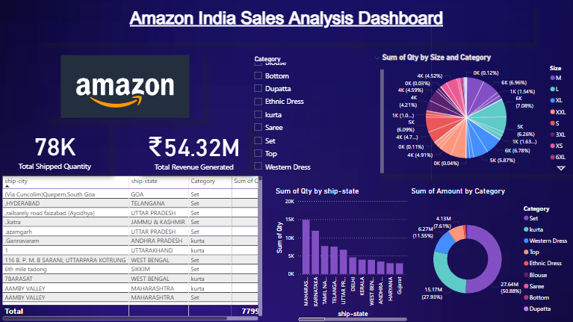
CEO
CFO
Sales Director
Berry Books
Vinny Viewer
Wendy Writer

Slide 15
Thank you.

